Slide 1
Advanced async programming using C# and F#
Tomas Petricek Microsoft MVP
http://tomasp.net/blog | @tomaspetricek

Slide 2
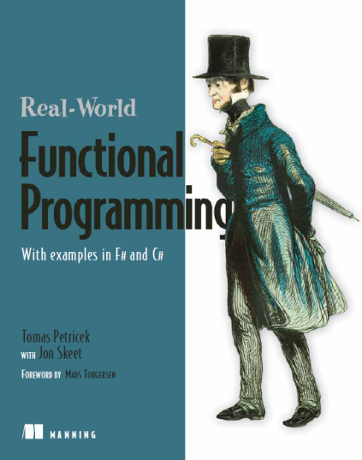

About me
Hipster F# programmer
Used F# before it was cool (blog in May 2006)
Contributed code to Visual Studio 2010
Wrote book about F#
Functional programming for C# developers
Functional and F# trainings
with Phil Trelford at SkillsMatter (London)
Ask us directly tomas@tomasp.net

Slide 3
Plan of the talk
Asynchronous programming (C# and F#)
Beyond async Asynchronous sequences
How they differ and how to combine them?

Slide 4
Synchronous

Slide 5
Asynchronous

Slide 6
Demo
Asynchronous web crawling

Slide 7
Demo
Reactive user interface programming

Slide 8
Plan of the talk
Asynchronous programming (C# and F#)
Beyond async Asynchronous sequences
How they differ and how to combine them?

Slide 9
Async workflows in F# and C#
Async Programming Differences
Await – Can be used inside expression in C#
Compilation – Lambda functions vs. state machines
Running vs. delayed – C# creates started Tasks
Cancellation – F# inserts cancellation checks
Other differences
Availability – F# async workflows used since 2008
Built-in? Computation expressions are more general

Slide 10
Demo
Implementing cancellation

Slide 11
Demo
Using F# agents from C#

Slide 12
Plan of the talk
Asynchronous programming (C# and F#)
Beyond async Asynchronous sequences
How they differ and how to combine them?

Slide 13
C# iterators and async
Iterators (C# 2.0)
Returns sequence of results
Can be suspended – runs on demand
State machine
Asynchronous methods (C# 5.0)
Can asynchronously wait
Can be suspended – when waiting
State machine

Slide 14
Demo
How C# async works?

Slide 15
F# computation expressions
Computation expressions
Compiled by calling library functions
Flexible syntax
Return one result using return
Return multiple results using yield
“Wait” for values using let!
Iterate over inputs using for

Slide 16
F# computation expressions
Computation expressions in F# libraries
F# asynchronous workflows
F# sequences
Third-party computations
Monads from functional programming
Cloud computations (m-brace)
Asynchronous sequences

Slide 17
Asynchronous sequences
Asynchronous workflows
One value
Controlled by consumer
IObservable
Multiple values
Controlled by producer
Asynchronous sequences
Multiple values
Controlled by consumer

Slide 18
Demo
Asynchronous sequences in F#

Slide 19
Conclusions
First-class async support
Available in F# now and in C# 5.0 (probably)
Allows interesting patterns
Parallel programming, GUI programming
F# has a few more things
Easy to call from C# using await

Slide 20

Thanks!
F# books and trainings http://functional-programming.net
Contact details tomas@tomasp.net | @tomaspetricek

